Slide 1
Database System
Lecture 5: Entity-Relationship Model
陈 刚
College of Computer Science
Zhejiang University
18667106736 / cg@zju.edu.cn

Slide 2

Outline
Entity Sets
Relationship Sets
Keys
E-R Diagram
Weak Entity Sets
Extended E-R Features
Design of an E-R Database Schema
Reduction of an E-R Schema to Tables
Lecture 5: Entity-Relationship Model — Database System

Slide 3
Entity Sets
The real world can be modeled as:
  A collection of entities (实体)
  Relationships (联系) among entities
An entity is an object that exists and is distinguishable from other objects. --- An entity may be concrete, or abstract.
  Example: specific student, company, event, plant.
Entities have attributes (属性)
  Example: student has id, name, age, sex, and address.
An entity set is a set of entities of the same type that share the same properties.
  Example: set of all students, companies, trees, holidays, customers, accounts, loans.
  一个实体集包含多个同类实体
Lecture 5: Entity-Relationship Model — Database System

Slide 4
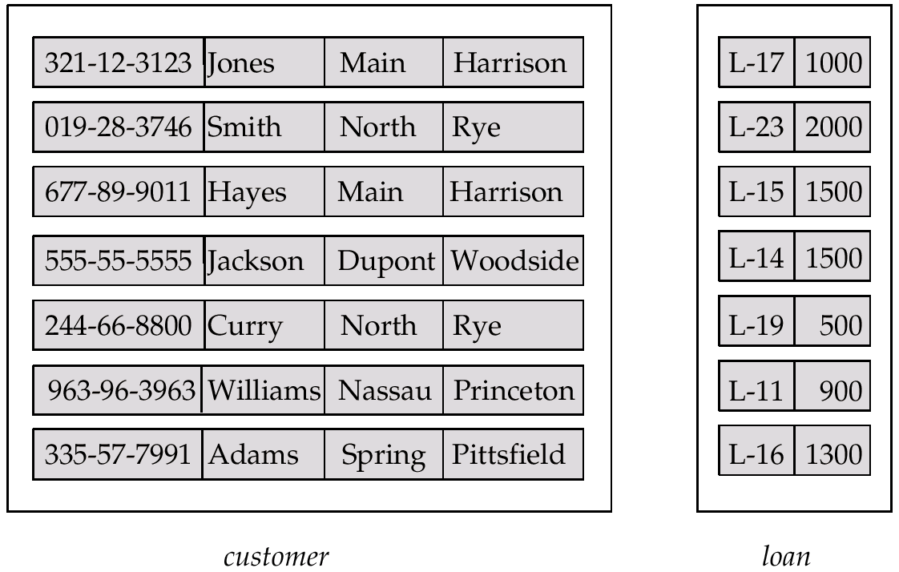
Example: Entity Sets customer and loan
Attribute names
customer-id customer- customer- customer- loan- amount
name street city number
Attribute value
An entity
Lecture 5: Entity-Relationship Model — Database System

Slide 5
Attributes
An entity is represented by a set of attributes, that is descriptive properties possessed by all members of an entity set.
Domain (域, value set) –– the set of permitted values for each attribute.
Attribute types:
  Simple and composite attributes (简单和复合属性，如sex, name).
  Single-valued and multi-valued attributes(单值和多值属性).
    E.g., multivalued attribute: phone-numbers (多个电话号码).
  Derived attributes (派生属性).
    Can be computed from other attributes, e.g., age, given date of birth.
    versus base attributes or stored attributes (基属性，存储属性).
Lecture 5: Entity-Relationship Model — Database System

Slide 6

Composite Attributes
复合属性
分量属性
Lecture 5: Entity-Relationship Model — Database System

Slide 7
Outline
Entity Sets
Relationship Sets
Keys
E-R Diagram
Weak Entity Sets
Extended E-R Features
Design of an E-R Database Schema
Reduction of an E-R Schema to Tables
Lecture 5: Entity-Relationship Model — Database System

Slide 8
Relationship Sets
A relationship is an association among several entities (是二个或多个不同类实体之间的关联).
A relationship set is a set of relationship of the same type.
  Example: borrower (customer-name, loan-number)
一个联系集包含多个同类联系 (或联系实例, relationship instance)
一个联系集表示二个或多个实体集之间的关联
Customer entity
loan entity
relationship
borrower1
( Jones , L-17 )
borrower2
( Smith , L-11 )
Lecture 5: Entity-Relationship Model — Database System

Slide 9
Relationship Sets (Cont.)
Formally, a relationship set is a mathematical relation among n ≥ 2 entities, each taken from entity sets
{(e₁, e₂, …, e_{n}) | e₁ ∈ E₁, e₂ ∈ E₂, …, e_{n} ∈ E_{n}}
where (e₁, e₂, …, e_{n}) is a relationship, E_{i} is an entity set.
  Example: (Jones, L-17) ∈ borrower, where Jones ∈ customer and L-17 ∈ loan
  (3032111020, 1, 95)
  (3032111021, 1, 90)
  (3032111022, 2, 75)
  … …
∈ student, course
Lecture 5: Entity-Relationship Model — Database System

Slide 10
Example 1
Students
Sid | Sname | Ssex | Sage | Specialty
3023001093 | Tom | M | 21 | Cs
3011112340 | Mary | F | 20 | Cs
3020621034 | Jack | M | 18 | Cs
3020831035 | Smith | M | 19 | Ma
3021131123 | Alane | F | 22 | Is
relationship
Enrolled
Courses
sid | cid | grade
3023001093 | 1 | 90
3023001093 | 2 | 85
3020621034 | 1 | 90
3020831035 | 1 | 75
3021131123 | 2 | 75
cid | Cname | credit
1 | DB | 4
2 | OS | 5
3 | English | 4
4 | Math | 4
Lecture 5: Entity-Relationship Model — Database System

Slide 11

Example 2: Relationship Set borrower
Borrower(customer-name, loan-number)
Lecture 5: Entity-Relationship Model — Database System

Slide 12

Example 3: Relationship Set
An attribute can also be the property of a relationship set.
For instance, the depositor relationship set between entity sets customer and account may have the attribute access-date.
depositor(customer-name, account-number, access-date)
Lecture 5: Entity-Relationship Model — Database System

Slide 13
Degree of a Relationship Set
Refers to the number of entity sets that participate in a relationship set.
Relationship sets that involve two entity sets are binary (or degree two).
Relationship sets may involve more than two entity sets.
  E.g., suppose employees of a bank may have jobs (responsibilities) at multiple branches, with different jobs at different branches. Then there is a ternary relationship set between entity sets (employee, job, branch)
Relationships between more than two entity sets are rare. Most relationships are binary. (More on this later.)
Lecture 5: Entity-Relationship Model — Database System

Slide 14
Mapping Cardinalities
Express the number of entities to which another entity can be associated via a relationship set. (一个联系集中，一个实体可以与另一类实体相联系的实体数目。其中数目是指最多一个还是多个)
Most useful in describing binary relationship sets.
For a binary relationship set the mapping cardinality must be one of the following types:
  One to one (1 : 1)，如：就任总统（总统，国家）
  One to many (1 : n)，如：分班情况（班级，学生）
  Many to one (n : 1)，如：就医（病人，医生）
  Many to many (n : m)，如：选课（学生，课程）
Lecture 5: Entity-Relationship Model — Database System

Slide 15

Mapping Cardinalities (Cont.)
One to one
One to many
Note: Some elements in entity set A and B may not be mapped to any elements in the other set.
Lecture 5: Entity-Relationship Model — Database System

Slide 16

Mapping Cardinalities (Cont.)
Many to one
Many to many
Note: Some elements in A and B may not be mapped to any elements in the other set.
Lecture 5: Entity-Relationship Model — Database System

Slide 17
Outline
Entity Sets
Relationship Sets
Keys
E-R Diagram
Weak Entity Sets
Extended E-R Features
Design of an E-R Database Schema
Reduction of an E-R Schema to Tables
Lecture 5: Entity-Relationship Model — Database System

Slide 18
Keys for Entity Sets
A super key of an entity set is a set of one or more attributes whose values uniquely determine each entity.
A candidate key of an entity set is a minimal super key.
  Customer-id is a candidate key of customer.
  Loan-number is a candidate key of loan.
Although several candidate keys may exist, one of the candidate keys is selected to be the primary key.
Example: customer(cus-num, cus-name, cus-street, cus-city)
  Candidate key: cus-num
  Super key: {cus-num}, {cus-num, cus-name}, {cus-num, …}
Lecture 5: Entity-Relationship Model — Database System

Slide 19
Keys for Relationship Sets
The combination of primary keys of the participating entity sets forms a super key of a relationship set (参与一个联系集的各实体集的码的组合，构成该联系集的超码).
(customer-id, loan-number) is the super key of borrower
  (sid, cid) is the super key of enrolled
  Note: this means a pair of entity can have at most one relationship in a particular relationship set.
Must consider the mapping cardinality of the relationship set when deciding what are the candidate keys (1:1, 1:n, m:n).
Need to consider semantics of relationship set in selecting the primary key in case of more than one candidate key, e.g. 作为码的属性不能为空，值不应常变.
Lecture 5: Entity-Relationship Model — Database System

Slide 20
Example 1
Students
Sid | Sname | Ssex | Sage | Specialty
3023001093 | Tom | M | 21 | Cs
3011112340 | Mary | F | 20 | Cs
3020621034 | Jack | M | 18 | Cs
3020831035 | Smith | M | 19 | Ma
3021131123 | Alane | F | 22 | Is
relationship
Enrolled
Courses
sid | cid | grade
3023001093 | 1 | 90
3023001093 | 2 | 85
3020621034 | 1 | 90
3020831035 | 1 | 75
3021131123 | 2 | 75
cid | Cname | credit
1 | DB | 4
2 | OS | 5
3 | English | 4
4 | Math | 4
Lecture 5: Entity-Relationship Model — Database System

Slide 21
Outline
Entity Sets
Relationship Sets
Keys
E-R Diagram
Weak Entity Sets
Extended E-R Features
Design of an E-R Database Schema
Reduction of an E-R Schema to Tables
Lecture 5: Entity-Relationship Model — Database System

Slide 22

E-R Diagrams
Rectangles represent entity sets.
Diamonds represent relationship sets.
Lines link attributes to entity sets and entity sets to relationship sets.
Ellipses represent attributes.
  Double ellipses represent multivalued attributes.
  Dashed ellipses denote derived attributes.
Underline indicates primary key attributes (will study later).
Lecture 5: Entity-Relationship Model — Database System

Slide 23

E-R Diagram With Composite, Multivalued, and Derived Attributes
Composite attribute
Derived attribute
Multivalued attribute
Lecture 5: Entity-Relationship Model — Database System

Slide 24

Relationship Sets with Attributes
Descriptive attribute of the relationship
Lecture 5: Entity-Relationship Model — Database System

Slide 25

E-R Diagrams
Entity sets of a relationship need not be distinct, e.g., Recursive relationship set (自环联系集).
Role: the function that an entity plays in a relationship, e.g., the labels “manager” and “worker” are called roles; they specify how employee entities interact via the works-for relationship set.
Role labels are optional, and are used to clarify semantics of the relationship.
role
Lecture 5: Entity-Relationship Model — Database System

Slide 26
Express the Cardinality Constraints
We express cardinality constraints by drawing either a directed line (→), signifying “one”, or an undirected line (—), signifying “many”, between the relationship set and the entity set.
Lecture 5: Entity-Relationship Model — Database System

Slide 27

One-To-One Relationship
A customer is associated with at most one loan via the relationship borrower.
A loan is associated with at most one customer via borrower.
注意: 一个联系集的类型取决于被表达对象的语义约束及设计者的意图.
Lecture 5: Entity-Relationship Model — Database System

Slide 28
One-To-Many Relationship
A loan is associated with at most one customer via borrower.
A customer is associated with several (including 0) loans via borrower.
one
many
Lecture 5: Entity-Relationship Model — Database System

Slide 29
Many-To-One Relationship
A loan is associated with several (including 0) customers via borrower.
A customer is associated with at most one loan via borrower.
Lecture 5: Entity-Relationship Model — Database System

Slide 30
Many-To-Many Relationship
A customer is associated with several (possibly 0) loans via borrower.
A loan is associated with several (possibly 0) customers via borrower.
Lecture 5: Entity-Relationship Model — Database System

Slide 31
Participation of an Entity Set in a Relationship Set
Total participation (全参与) (indicated by double line): every entity in the entity set participates in at least one relationship in the relationship set.
  E.g., participation of loan in borrower is total.
  Every loan must have a customer associated to it via borrower.
Partial participation (部分参与): some entities may not participate in any relationship in the relationship set.
  E.g., participation of customer in borrower is partial.
Lecture 5: Entity-Relationship Model — Database System

Slide 32

Participation of an Entity Set in a Relationship Set (Cont.)
映射基数约束(Mapping cardinality constraints)，限定了一个实体与发生关联的另一端实体可能关联的数目上限。
全参与和部分参与约束，则反映了一个实体参与关联的数目下限：0次，还是至少1次。
partial participation
Total participation
Lecture 5: Entity-Relationship Model — Database System

Slide 33

Alternative Notation for relationship Constraints
Alternative notation for cardinality constraints and participation constraints.
E.g., 一个客户可以借多笔或0笔贷款，一笔贷款至少、至多属于一个客户。
1..1: 至少至多一个
customer
borrower
loan
Lecture 5: Entity-Relationship Model — Database System

Slide 34

E-R Diagram with a Ternary Relationship
一个银行职员在多个支行兼职，并承担不同类型的工作。
Lecture 5: Entity-Relationship Model — Database System

Slide 35
Binary vs. Non-Binary Relationships
Some relationships that appear to be non-binary may be better represented using binary relationships.
  E.g., a ternary relationship parents, relating a child to his/her father and mother, is best replaced by two binary relationships, father and mother.
  parents(he, she, child) => father(he, child), mother(she, child)
  Using two binary relationships allows partial information, e.g., only mother being know.
  But there are some relationships that are naturally non-binary, e.g., works-on(employee, branch, job).
Lecture 5: Entity-Relationship Model — Database System

Slide 36

Converting Non-Binary Relationships to Binary Form
In general, any non-binary relationship can be represented using binary relationships by creating an artificial entity set.
  Replace non-binary relationship R between entity sets A, B, and C by an entity set E, and three new relationship sets.
  Create a special identifying attribute for E.
  Add any attributes of R to E.
  For each relationship (a_{i}, b_{i}, c_{i}) in R, create R_{A}, R_{B}, R_{C}.
convert
Lecture 5: Entity-Relationship Model — Database System

Slide 37
Converting Non-Binary Relationships to Binary Form (Cont.)
In general, any non-binary relationship can be represented using binary relationships by creating an artificial entity set.
  Replace non-binary relationship R between entity sets A, B, and C by an entity set E, and three new relationship sets.
  Create a special identifying attribute for E.
  Add any attributes of R to E.
  For each relationship (a_{i}, b_{i}, c_{i}) in R, create R_{A}, R_{B}, R_{C}.
E.g.,
teaching
teacher
teacher
student
schooling
enroll
course
student
course
place
c-room
c-room
Lecture 5: Entity-Relationship Model — Database System

Slide 38
Outline
Entity Sets
Relationship Sets
Keys
E-R Diagram
Weak Entity Sets
Extended E-R Features
Design of an E-R Database Schema
Reduction of an E-R Schema to Tables
Lecture 5: Entity-Relationship Model — Database System

Slide 39
Weak Entity Sets
An entity set that does not have a primary key is referred to as a weak entity set.
  E.g., 还贷登记表 payment(pay-num, pay-date, pay-amount). 假设为了清楚起见，pay-num按对应的每项贷款分别编号(都从1, 2, 3 …开始), 这样，pay-num就不是码，并且该实体集没有码。故payment是弱实体集。 pay-num is discriminator or partial key (分辨符或部分码).
  C.f. weak entity set Vs. strong entity set.
pay-date
Loan-number
amount
Pay-amount
pay-num
？
loan
payment
Lecture 5: Entity-Relationship Model — Database System

Slide 40
Weak Entity Sets (Cont.)
The existence of a weak entity set depends on the existence of a identifying entity set or owner entity set (标识实体集或属主实体集).
  E.g., loan(loan-num, amount) is an identifying entity set.
  It must relate to the identifying entity set via a total, one-to-many relationship set from the identifying to the weak entity set.
The related relationship is called identifying relationship (标识性联系)
  E.g., loan-payment
Lecture 5: Entity-Relationship Model — Database System

Slide 41
Weak Entity Sets (Cont.)
The discriminator or partial key (分辨符或部分码) of a weak entity set is the set of attributes that distinguishes among all those entities in a weak entity set that depend on one particular strong entity (e.g., payment-number).
The primary key of a weak entity set is formed by the primary key of the strong entity set on which the weak entity set is existence dependent, plus the weak entity set’s discriminator.
Lecture 5: Entity-Relationship Model — Database System

Slide 42

Weak Entity Sets (Cont.)
Primary key for payment(loan-number, payment-number)
payment-number is discriminator of the payment entity set
Owner entity set
identifying relationship
Weak entity set
Lecture 5: Entity-Relationship Model — Database System

Slide 43
Weak Entity Sets (Cont.)
Note: the primary key of the strong entity set is not explicitly stored with the weak entity set, since it is implicit in the identifying relationship.
If loan-number were explicitly stored, payment could be made a strong entity, but then the relationship between payment and loan would be duplicated by an implicit relationship defined by the attribute loan-number common to payment and loan.
Lecture 5: Entity-Relationship Model — Database System

Slide 44
Outline
Entity Sets
Relationship Sets
Keys
E-R Diagram
Weak Entity Sets
Extended E-R Features
Design of an E-R Database Schema
Reduction of an E-R Schema to Tables
Lecture 5: Entity-Relationship Model — Database System

Slide 45
Extended E-R features
Stratum of the entity set
  Specialization (特殊化、具体化)
    Top-down design process; we designate subgroupings within an entity set that are distinctive from other entities in the set.
    These subgroupings become lower-level entity sets that have attributes or participate in relationships that do not apply to the higher-level entity set.
    Attribute inheritance – a lower-level entity set inherits all the attributes and relationship participation of the higher-level entity set to which it is linked.
Lecture 5: Entity-Relationship Model — Database System

Slide 46

Specialization Example
Lecture 5: Entity-Relationship Model — Database System

Slide 47
Extended E-R features (Cont.)
Stratum of the entity set (Cont.)
  Generalization (泛化、普遍化)
    A bottom-up design process – combine a number of entity sets that share the same features into a higher-level entity set.
    Specialization and generalization are simple inversions of each other; they are represented in an E-R diagram in the same way.
    The terms specialization and generalization are used interchangeably.
Lecture 5: Entity-Relationship Model — Database System

Slide 48

Design Constraints on a Specialization / Generalization
Constraint on which entities can be members of a given lower-level entity set.
  Condition-defined (条件定义的)
    E.g., (1) All customers over 65 years are members of senior-citizen entity set; senior-citizen ISA person; (2) account to saving account or saving accounts.
  User-defined, e.g., employee to teams
Constraint on whether or not entities may belong to more than one lower-level entity set within a single generalization.
  Disjoint (不相交)
    An entity can belong to only one lower-level entity set.
    Noted in E-R diagram by writing disjoint next to the ISA triangle.
  Overlapping (可重叠)
    An entity can belong to more than one lower-level entity set.
    E.g.,
account
ISA
Saving-account
Disj
checking-account
person
ISA
customer
employee
Lecture 5: Entity-Relationship Model — Database System

Slide 49

Design Constraints on a Specialization / Generalization (Cont.)
Completeness constraint (完全性约束) -- specifies whether or not an entity in the higher-level entity set must belong to at least one of the lower-level entity sets within a generalization.
  Total: an entity must belong to one of the lower-level entity sets.
  Partial: an entity need not belong to one of the lower-level entity sets.
account
（完全泛化）
ISA
Saving-account
Disj
checking-account
person
（部分泛化）
ISA
customer
employee
Lecture 5: Entity-Relationship Model — Database System

Slide 50
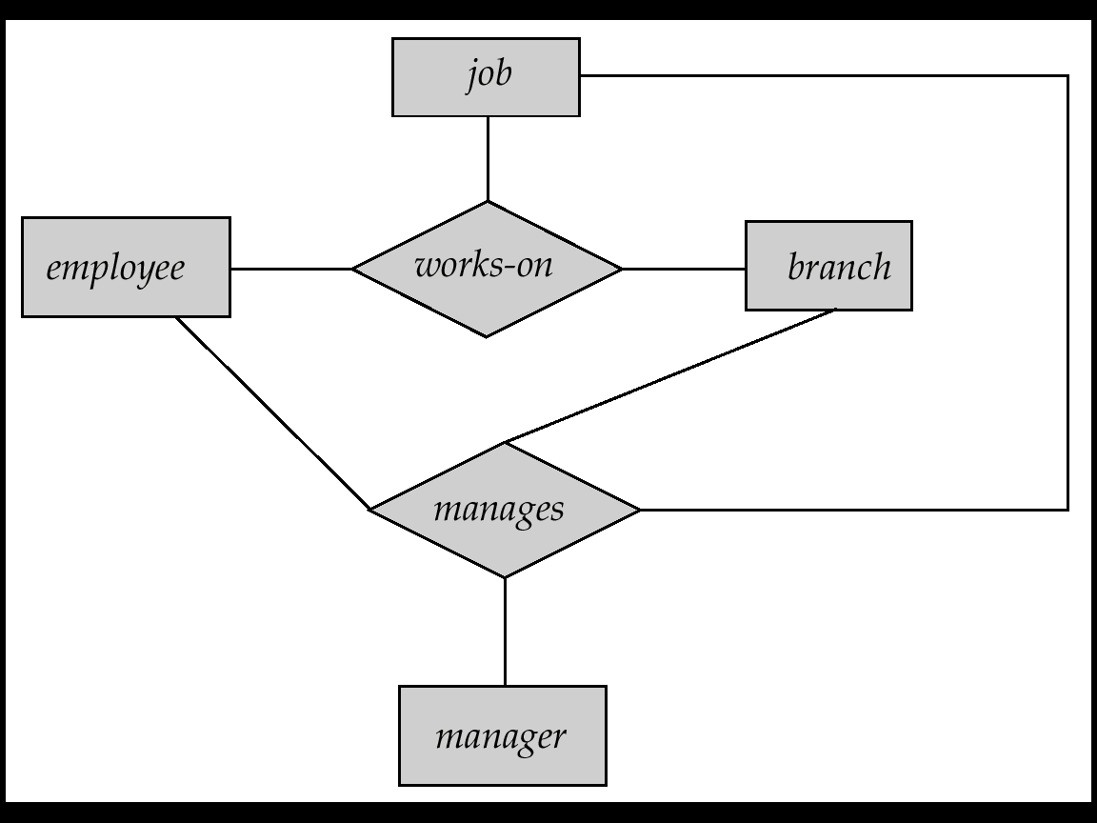
Aggregation
How to express relationships among relationships ?
Consider the ternary relationship works-on, which we saw earlier. Suppose we want to record managers for tasks performed by an employee at a branch.
Lecture 5: Entity-Relationship Model — Database System

Slide 51
Aggregation (Cont.)
Relationship sets works-on and manages represent overlapping information.
  Every manages relationship corresponds to a works-on relationship.
  However, some works-on relationships may not correspond to any manages relationships.
    So we can’t discard the works-on relationship.
Eliminate this redundancy via aggregation.
  Treat relationship as an abstract entity.
  Allows relationships between relationships.
  Abstraction of relationship into new entity.
Without introducing redundancy, the following diagram represents:
  An employee works on a particular job at a particular branch.
  An employee, branch, job combination may have an associated manager.
Lecture 5: Entity-Relationship Model — Database System

Slide 52

E-R Diagram With Aggregation
复合实体集
Lecture 5: Entity-Relationship Model — Database System

Slide 53

Summary of Symbols Used in E-R Notation
Lecture 5: Entity-Relationship Model — Database System

Slide 54
Summary of Symbols (Cont.)
Lecture 5: Entity-Relationship Model — Database System

Slide 55

Alternative E-R Notations
Lecture 5: Entity-Relationship Model — Database System

Slide 56
Outline
Entity Sets
Relationship Sets
Keys
E-R Diagram
Weak Entity Sets
Extended E-R Features
Design of an E-R Database Schema
Reduction of an E-R Schema to Tables
Lecture 5: Entity-Relationship Model — Database System

Slide 57
Design of an E-R Database Schema
Requirment analysis
  What data, applications, and operations needed.
Conceptual database design
  A high-level description of data, constraints using E-R model or a similar high level data model.
Logical database design
  Convert the conceptual design into DB schema --- tables
  Schema refinement: Normalization of relations --- Check relational schema for redundancies and related anomalies.
Physical database design
  Indexing, clustering and database tuning.
Lecture 5: Entity-Relationship Model — Database System

Slide 58

Complementarity
Steps of database design
数据库的设计步骤
（数据模型）逻辑模型
物理模型
概念模型
现实世界
信息世界
E-R 图
机器世界
关系模式（表结构）
物理存储结构
Lecture 5: Entity-Relationship Model — Database System

Slide 59
需求分析
目标组织
结构设计
行为设计
概念结构设计
数据分析
行为分析(用户业务活动分析)
设计局部视图
设计集成视图
概念模型设计
功能模型, 功能说明
逻辑结构设计
逻辑模型设计
事务处理设计(概要设计)
设计逻辑结构
优化逻辑模型
子模式设计
应用程序设计 (详细设计)
物理模型设计
应用程序编码
物理结构设计
设计物理结构
加载试验数据
程序调试和试运行
评价物理结构
功能、性能考核
数据库实施
N
满意？
数据库系统开发步骤
物理实现
Y
试运行(加载试验数据)
加载数据库
数据库运行维护
运行、维护
Lecture 5: Entity-Relationship Model — Database System

Slide 60
E-R Design Decisions
(1) Use an attribute or entity set to represent an object?
  E.g. 1: employee(emp-id, emp-name, …, phone)
  优点：简单; 但多个电话怎么处理？电话的其他属性？
  E.g. 2: employee(emp-id, emp-name, …);
  phone(phone-num, location, type, color);
  emp-phone(emp-id, phone-num)
  若一个对象只对其名字及单值感兴趣，则可作为属性，如性别；若一个对象除名字外，本身还有其他属性需描述，则该对象应定义为实体集。如电话, 部门.
  一个对象不能同时作为实体和属性.
  一个实体集不能与另一实体集的属性相关联，只能实体与实体相联系.
Lecture 5: Entity-Relationship Model — Database System

Slide 61
E-R Design Decisions (Cont.)
(2) Use it as an entity set or a relationship set?
  E.g., enrolled, borrower, depositor
  Relationship set --- to describe an action that occurs between entities (二个对象之间发生的动作 --- 用“relationship set”表示).
  The mapping cardinality will effect the matter.
  Considering the branch, loan, customer, …
customer
loan
branch
Loan-num
amount
customer
borrow
loan
Loan-bra
branch
Loan-num
amount
Lecture 5: Entity-Relationship Model — Database System

Slide 62
E-R Design Decisions (Cont.)
(3) Use it as an attribute of an entity or a relationship?, e.g., student(sid, name, sex, age, …, supervisor-id, supervisor-name, supervisor-position, …, class, monitor)
  要从对象的语义独立性和减少数据冗余方面考虑
  student(sid, name, sex, age, …);
  supervisor(sup-id, name, position, …);
  class(classno, specialty, monitor, stu-num);
  stu-class(sid, classno);
  stu-sup(sid, sup-id, from, to);
Lecture 5: Entity-Relationship Model — Database System

Slide 63
E-R Design Decisions (Cont.)
(4) The use of a ternary or n-ary relationship versus a pair of binary relationships.
*(5) The use of a strong or weak entity set.
*(6) The use of specialization/generalization – contributes to modularity in the design (有助于模块化).
*(7) The use of aggregation – can group a part of E-R diagram into a single entity set, and treat it as a single unit without concern for the details of its internal structure.
Lecture 5: Entity-Relationship Model — Database System

Slide 64
Example: Design of Banking Database
Get system requirements
  Branch, customer, employee, loan
  Account: saving account, checking account
Entity sets design
  Branch(branch-name, branch-city, assets)
  Customer(cust-id, cust-name, cust-street, cust-city)
  Employee(emp-id, emp-name, phone, salary)
  Account(acc-number, balance),
  Saving-acc(interest-rate),
  Checking-acc(overdraft-amount)
  Loan(loan-number, amount)
  Payment(pay-number, pay-date, pay-amount)
Lecture 5: Entity-Relationship Model — Database System

Slide 65
Example: Design of Banking Database (Cont.)
Relationship sets design
  Borrower: customer ---- loan
  Depositor: account ---- customer (account-date)
  Loan-branch: loan → branch
  Account-branch: account → branch
  Cust-banker: coustomer → employee (type)
  Works-for: manager ← worker
E-R diagram
Lecture 5: Entity-Relationship Model — Database System

Slide 66

E-R Diagram for a Banking Enterprise
Account-branch
Lecture 5: Entity-Relationship Model — Database System

Slide 67
Outline
Entity Sets
Relationship Sets
Keys
E-R Diagram
Weak Entity Sets
Extended E-R Features
Design of an E-R Database Schema
Reduction of an E-R Schema to Tables
Lecture 5: Entity-Relationship Model — Database System

Slide 68
Reduction of an E-R Schema to Tables
Converting an E-R diagram to a table format is the basis for deriving a relational database design from an E-R diagram.
A database which conforms to an E-R diagram can be represented by a collection of tables.
For each entity set and relationship set, there is a unique table which is assigned the name of the corresponding entity set or relationship set.
Lecture 5: Entity-Relationship Model — Database System

Slide 69
Representing Entity Sets as Tables
A strong entity set => to a table with the same attributes.
customer(customer-id, cust-name, cust-street, cust-city);
branch(branch-name, branch-city, assets);
account(account-number, balance);
loan(loan-number, amount);
employee(employee-id, employee-name, phone, start-date);
Lecture 5: Entity-Relationship Model — Database System

Slide 70
Entity Set with Composite Attributes
Composite attributes are flattened out by creating a separate attribute for each component attribute.
  E.g., given entity set customer with composite attribute name with component attributes first-name and last-name. The table corresponding to the entity set has two attributes:
  name.first-name and name.last-name
  or first-name and last-name
customer(customer-id, first-name, last-name, cust-street, cust-city)
Lecture 5: Entity-Relationship Model — Database System

Slide 71
Entity Set with Multivalued Attributes
A multivalued attribute M of an entity E is represented by a separate table EM:
  E.g., multivalued attribute dependent-names of employee is represented by a table
  employee(emp-id, ename, sex, age, dependent-names)
  employee(emp-id, ename, sex, age),
  employee-dependent-names(emp-id, dependent-name)
  Each value of the multivalued attribute maps to a separate row of the table EM
    E.g., an employee entity with primary key John and dependents Johnson and Johndoter maps to two rows:
    (John, Johnson) and (John, Johndoter) in relation employee-dependent-names.
Lecture 5: Entity-Relationship Model — Database System

Slide 72
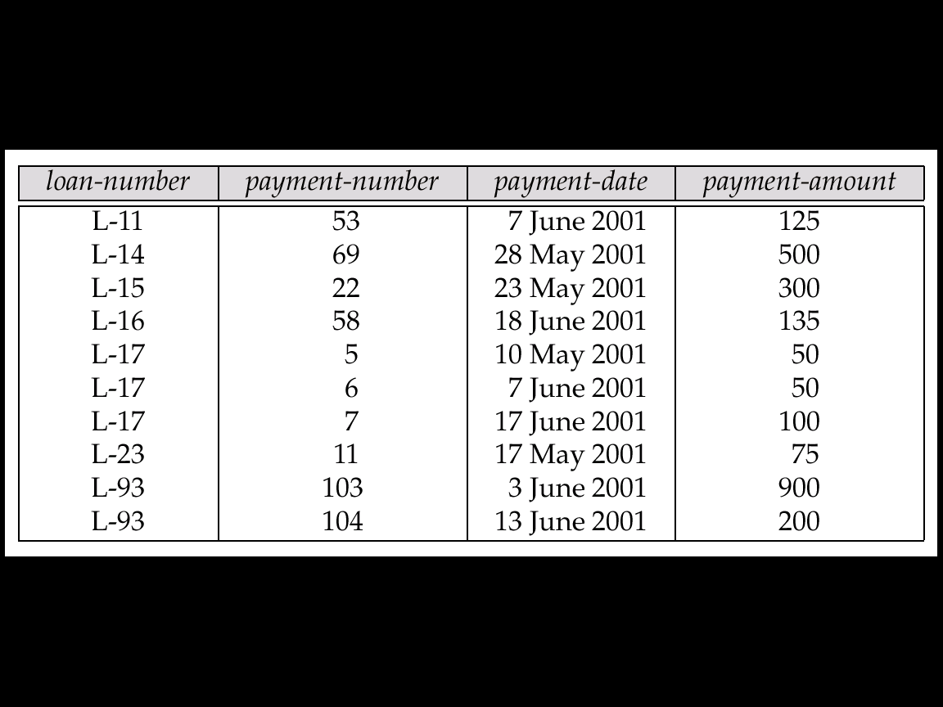
Representing Weak Entity Sets
A weak entity set becomes a table that includes a column for the primary key of the identifying strong entity set.
payment(loan-number, payment-number, payment-date, payment-amount)
Lecture 5: Entity-Relationship Model — Database System

Slide 73
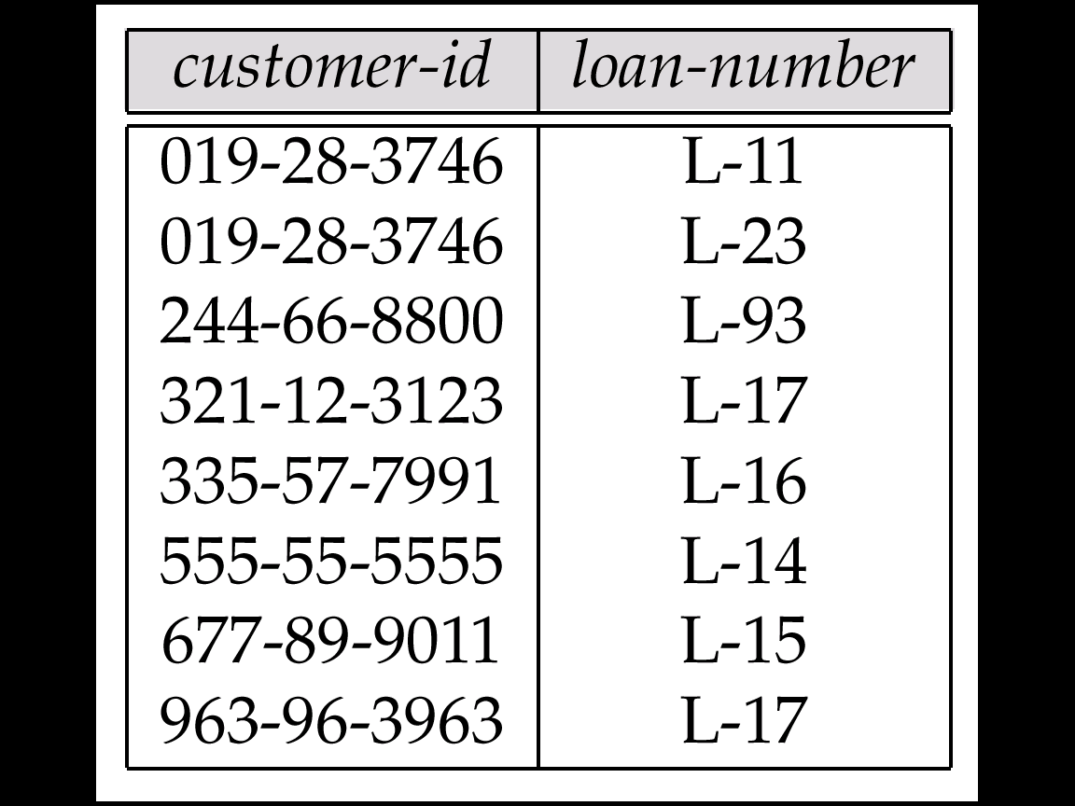
Representing Relationship Sets as Tables
A relationship set is represented as a table with columns for the primary keys of the two participating entity sets, (which are foreign keys here) and any descriptive attributes of the relationship set itself.
(a) tables for many to many relationship sets:
borrower(customer-id, loan-number);
depositor(customer-id, account-number, access-date)
borrower
The two attributes corresponding to the two entity sets become the primary key of the table.
Lecture 5: Entity-Relationship Model — Database System

Slide 74
Representing Relationship Sets as Tables (Cont.)
(b) tables for many to one relationship sets:
loan-branch(loan-number, branch-name);
account-branch(account-number, branch-name);
cust-banker(customer-id, employee-id, type);
works-for(employee-id, manager);
loan-payment(loan-number, payment-number)
(c) tables for one to one relationship sets: like (b)
The attribute corresponding to the entity set on the “many” side becomes the primary key of the table.
Lecture 5: Entity-Relationship Model — Database System

Slide 75

Redundancy of Tables
Many-to-one and one-to-many relationship sets that are total on the many-side can be represented by adding an extra attribute to the “many” side, containing the primary key of the one side (对1:n联系，可将“联系”所对应的表，合并到对应“多”端实体的表中).
account(account-number, balance); branch(branch-name, branch-city, assets);
account-branch(account-number, branch-name)
account(account-number, branch-name, balance)
Lecture 5: Entity-Relationship Model — Database System

Slide 76
Redundancy of Tables (Cont.)
If participation is partial on the many side, replacing a table by an extra attribute in the relation corresponding to the “many” side could result in null values.
  E.g., cust-banker(customer-id, employee-id, type); 但有的customer没有banker, 则合并之后得：
  Customer(customer-id, cust-name, cust-street, cust-city, banker-id, type) ，导致Customer中有些元组的banker-id、 type为null)。
For one-to-one relationship sets, either side can be chosen to act as the “many” side
  That is, extra attribute can be added to either of the tables corresponding to the two entity sets.
Lecture 5: Entity-Relationship Model — Database System

Slide 77
account-branch(account-number, branch-name);
account(account-number, balance);
loan-branch(loan-number, branch-name);
loan(loan-number, amount);
loan(loan-number, branch-name, amount);
cust-banker(customer-id, employee-id, type);
customer(customer-id, customer-name, customer-street, customer-city);
works-for(employee-id, manager);
employee(employee-id, employee-name, phone, start-date);
employee(employee-id, employee-name, phone, start-date, manager);
Lecture 5: Entity-Relationship Model — Database System

Slide 78
Redundancy of Tables (Cont.)
(b) The table corresponding to a relationship set linking a weak entity set to its identifying strong entity set is redundant (联系弱实体集及其标识性实体集的联系集对应的表是冗余的，即对应identifying relationship的表是多余的。).
  E.g., The payment table already contains the information that would appear in the loan-payment table (i.e., the columns loan-number and payment-number).
Owner entity set
identifying relationship
Weak entity set
Lecture 5: Entity-Relationship Model — Database System

Slide 79
Payment(loan-number, payment-number, payment-date, paymeny-amount)
Loan-payment (loan-number, payment-number )
Lecture 5: Entity-Relationship Model — Database System

Slide 80
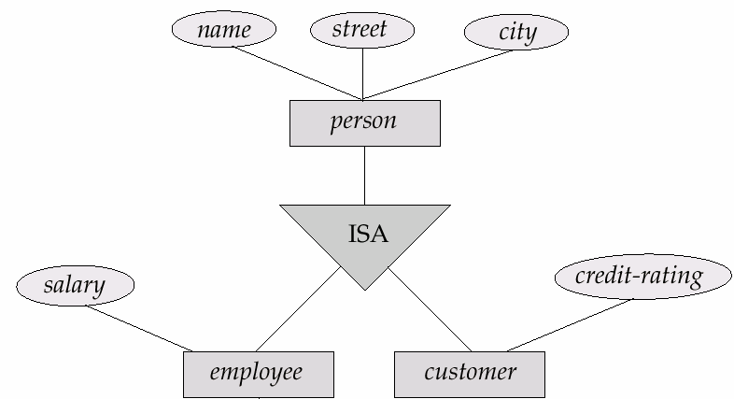
Representing Specialization as Tables
Method 1:
  Form a table for the higher level entity.
  Form a table for each lower level entity set, including primary key of higher level entity set and local attributes.
  table table attributes
  person person-id, name, street, city
  customer person-id, credit-rating
  employee person-id, salary
  Drawback: getting information about, e.g.,
  employee, requires accessing two tables.
Lecture 5: Entity-Relationship Model — Database System

Slide 81
Representing Specialization as Tables (Cont.)
Method 2:
  Form a table for each entity set with all local and inherited attributes.
  table table attributes
  person person-id, name, street, city
  customer person-id, name, street, city, credit-rating
  employee person-id, name, street, city, salary
  If specialization is total, table for generalized
  entity (person) not required to store information.
    person can be defined as a “view” relation containing
    union of specialization tables
  Drawback: street and city may be stored redundantly
  for persons who are both customers and employees
Lecture 5: Entity-Relationship Model — Database System

Slide 82
Banking Database
branch(branch-name, branch-city, assets)
customer(customer-name, customer-street, customer-city, banker-id)
account(account-number, branch-name, balance)
loan(loan-number, branch-name, amount)
depositor(customer-name, account-number)
borrower(customer-name, loan-number)
Employee(employee-id, employee-name, phone, start-date, manager)
Payment(loan-number, payment-number, payment-date, paymeny-amount)
Lecture 5: Entity-Relationship Model — Database System

Slide 83
Example 2
A company database needs to store information about employees (identified by empid, with name, salary and phone as attributes); departments (identified by dno, with dname and budget as attributes) and children of the empoyee(with name and age as attributes). Employees work in departments; each department is managed by an employee; a child must be identified uniquely by name when parent (who is an employee; assume that only one parent works for the company) is known. We are not interested in information about a child once the parent leaves the company. Draw an E-R diagram that captures this information, and then transform it into relational schema.
Lecture 5: Entity-Relationship Model — Database System

Slide 84
Example 2 (Cont.)
empid
name
salary
phone
dno
Work-at
dname
employees
departments
budget
managed
Has-child
Employees(empid, ename, salary, phone)
Departments(dno, dname, budget)
Children(empid, name, age)
Has-child(empid, name)
Work-at(empid, dno)
Managed(manager-id, dno)
chidren
name
age
Departments(dno, dname, budget, manager-id)
Lecture 5: Entity-Relationship Model — Database System

Slide 85
Example 3
Students take courses. Each student has a student ID number, name, age, and gender. Each course has a course ID number, name, credits and room number. Each student is either an undergraduate or graduate student. For each undergraduate student, we want to record also his/her year, GPA, and (possibly multiple) email addresses. For each graduate student, we want to record his/her advisor name, and also his/her multiple email addresses. In addition, each course is assigned to exactly one graduate student, who acts as the TA (助教) of the course. For this TA role we want to record the start and end times(e.g., start at 11/02/28 and ends at 11/06/28). Please draw an E-R diagram that captures these information.
Lecture 5: Entity-Relationship Model — Database System

Slide 86
Example 3 (Cont.)
name
gender
name
room
S-ID
age
C-ID
credits
student
course
take
score
Start_t
ISA
TA
disjoint
End_t
undergraduate
Graduate
year
GPA
email
advisor
email
Lecture 5: Entity-Relationship Model — Database System

Slide 87

Q & A
Your questions and suggestions are expected for me.
Thanks a lot!
Questions?
Exercises: 6.1, 6.2, 6.21, 6.22, and 5.24 (see Pages 294-299)
Lecture 5: Entity-Relationship Model — Database System

